Slide 1
syslog-ng

Slide 2
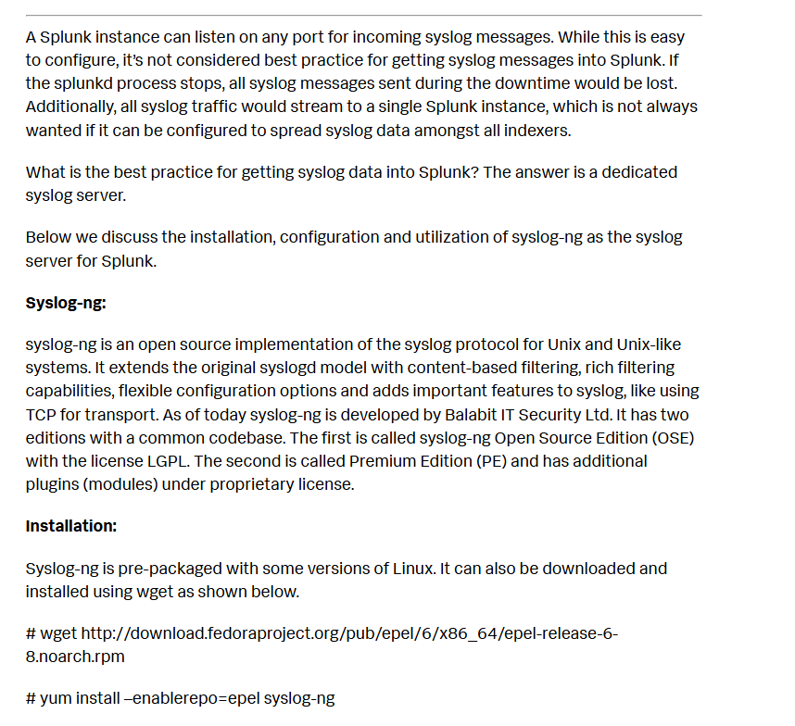

Slide 3
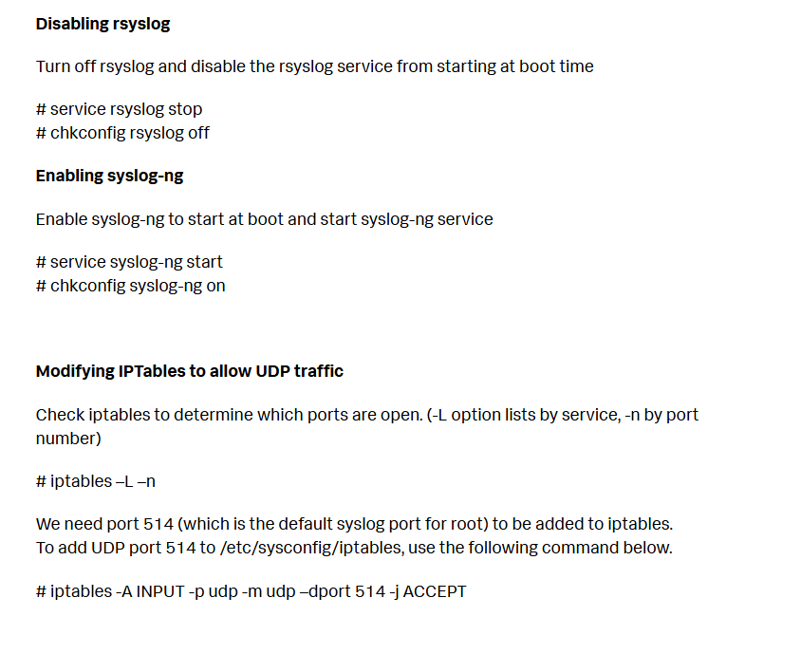

Slide 4
Modifying syslog-ng.conf Copy the existing syslog-ng.conf file to syslog-ng.conf.sav before editing it. The syslog-ng.conf example file below was used with Splunk 6. Each unique data source type had a directory created under /home/syslog/logs. This was done using destination options with the create_dirs attribute set to yes.
@version:3.2
# syslog-ng configuration file. # # options { chain_hostnames(no); create_dirs (yes); dir_perm(0755); dns_cache(yes); keep_hostname(yes); log_fifo_size(2048); log_msg_size(8192); perm(0644); time_reopen (10); use_dns(yes); use_fqdn(yes); };
source s_network { udp(port(514)); };

Slide 5
#Destinations destination d_cisco_asa { file(“/home/syslog/logs/cisco/asa/$HOST/$YEAR-$MONTH-$DAY-cisco-asa.log” create_dirs(yes)); }; destination d_palo_alto { file(“/home/syslog/logs/paloalto/$HOST/$YEAR-$MONTH-$DAY-palo.log” create_dirs(yes)); }; destination d_all { file(“/home/syslog/logs/catch_all/$HOST/$YEAR-$MONTH-$DAY-catch_all.log” create_dirs(yes)); };
# Filters filter f_cisco_asa { match(“%ASA” value(“PROGRAM”)) or match(“%ASA” value(“MESSAGE”)); }; filter f_palo_alto { match(“009401000570” value(“PROGRAM”)) or match(“009401000570” value(“MESSAGE”)); }; filter f_all { not ( filter(f_cisco_asa) or filter(f_palo_alto) ); };
# Log log { source(s_network); filter(f_cisco_asa); destination(d_cisco_asa); }; log { source(s_network); filter(f_palo_alto); destination(d_palo_alto); }; log { source(s_network); filter(f_all); destination(d_all); };
Restarting syslog-ng Syslog-ng can be restarted by executing the script in /etc/init.d or by issuing the service syslog-ng stop | start | restart commands shown below
# service syslog-ng stop Stopping syslog-ng: [ OK ]

Slide 6
Removing old log files from syslog-ng server To ensure syslog-ng doesn’t fill the filesystem up with log files, create a cron job which runs daily at 5AM to remove old syslog-ng log files after “x” days. The example below runs every morning at 5am and removes files older than 7 days.
# crontab –e 0 7 * * * /bin/find /home/syslog/logs/ -type f -name \*.log -mtime +7 -exec rm {} \;
Use the crontab –l command to see what other cron jobs may exist or to check to ensure the cron job scheduled is correct.
UF collection on syslog-ng server
Install a Universal Forwarder on the machine where the syslog-ng server is installed. The UF on the syslog-ng server can collect events from log files written from Cisco ASA and Palo Alto firewall devices. The monitor stanza below will monitor everything below the filesystem listed
Notice the attribute host_segment is used to identify the position of the hostname relative to the full path from the left.
# Cisco ASA [monitor:///home/syslog/logs/cisco/asa/*/*.log] sourcetype = cisco:asa index = cisco disabled = false host_segment = 6
Splunk walks the filesystem path to the sixth field and sets the hostname for the events to the value found.
/home/syslog/logs/cisco/asa/<hostname>/2014-09-10-cisco-asa.log

Slide 7
# Cisco ASA [monitor:///home/syslog/logs/cisco/asa/*/*.log] sourcetype = cisco:asa index = cisco disabled = false host_segment = 6
Splunk walks the filesystem path to the sixth field and sets the hostname for the events to the value found.
/home/syslog/logs/cisco/asa/<hostname>/2014-09-10-cisco-asa.log

Slide 8
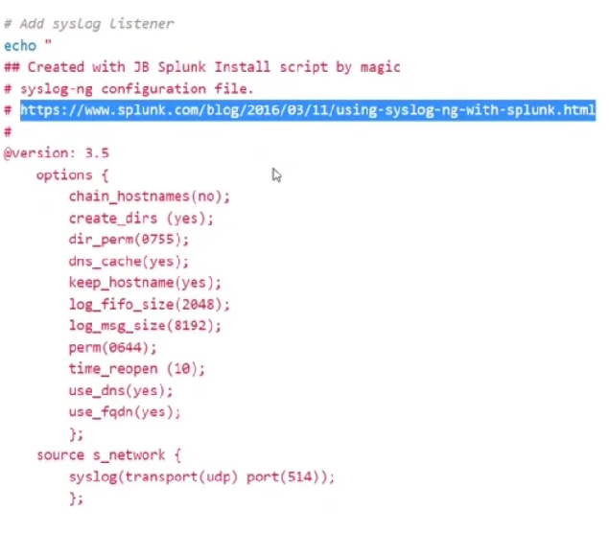

Slide 9
